Slide 1
CENG401 MACHINE LEARNING AND ARTIFICIAL INTELLIGENCE
WEEK-11
MACHINE LEARNING
Naive Bayes
CART
Asst.Prof.Dr. Murat ŞİMŞEK

Slide 2
Supervised Learning

Slide 3
Naïve Bayes

Slide 4

Naïve Bayes
Naïve Bayes algorithm is a supervised learning algorithm, which is based on Bayes theorem and used for solving classification problems.

Slide 5
Naïve Bayes
Naïve Bayes Classifier is one of the simple and most effective Classification algorithms which helps in building the fast machine learning models that can make quick predictions.
It is a probabilistic classifier, which means it predicts on the basis of the probability of an object.

Slide 6
Why is it called Naïve Bayes?
The Naïve Bayes algorithm is comprised of two words Naïve and Bayes, Which can be described as:
Naïve: It is called Naïve because it assumes that the occurrence of a certain feature is independent of the occurrence of other features.
Such as if the fruit is identified on the bases of color, shape, and taste, then red, spherical, and sweet fruit is recognized as an apple. Hence each feature individually contributes to identify that it is an apple without depending on each other.
Bayes: It is called Bayes because it depends on the principle of Bayes' Theorem.

Slide 7
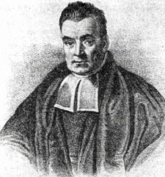
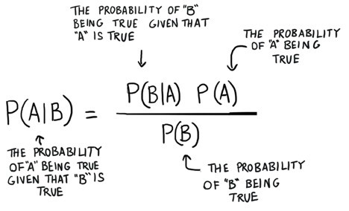
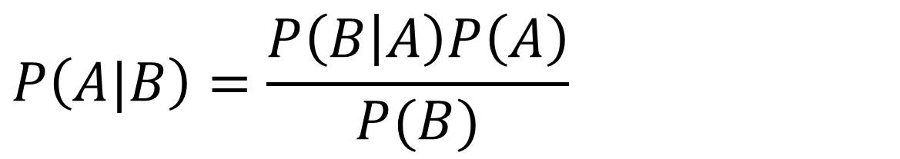
Bayes rule
$$P\left(A|B\right)=\frac{P\left(B | A\right)P\left(A\right)}{P(B)}$$
Thomas Bayes
Notes:
P ( A | B ) = B olayı gerçekleştiğinde A olayının gerçekleşme olasılığı P ( A ) = A olayının gerçekleşme olasılığı P ( B | A ) = A olayı gerçekleştiğinde B olayının gerçekleşme olasılığı P ( B ) = B olayının gerçekleşme olasılığı

Slide 8
Bayes rule
P(A|B) is Posterior probability: Probability of hypothesis A on the observed event B.
P(B|A) is Likelihood probability: Probability of the evidence given that the probability of a hypothesis is true.
P(A) is Prior Probability: Probability of hypothesis before observing the evidence.
P(B) is Marginal Probability: Probability of Evidence.
Notes:
P ( A | B ) = B olayı gerçekleştiğinde A olayının gerçekleşme olasılığı P ( A ) = A olayının gerçekleşme olasılığı P ( B | A ) = A olayı gerçekleştiğinde B olayının gerçekleşme olasılığı P ( B ) = B olayının gerçekleşme olasılığı

Slide 9
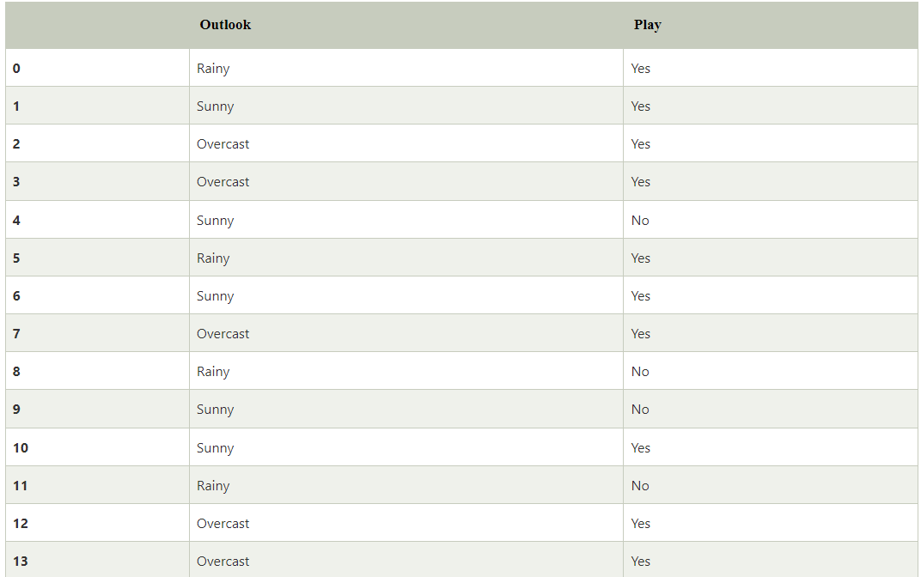
Working of Naïve Bayes' Classifier
Suppose we have a dataset of weather conditions and corresponding target variable "Play".
So using this dataset we need to decide that whether we should play or not on a particular day according to the weather conditions.
Notes:
So to solve this problem, we need to follow the below steps:
Convert the given dataset into frequency tables.
Generate Likelihood table by finding the probabilities of given features.
Now, use Bayes theorem to calculate the posterior probability.
Problem: If the weather is sunny, then the Player should play or not?
Solution: To solve this, first consider the below dataset:

Slide 10
Working of Naïve Bayes' Classifier
To solve this problem, we need to follow the below steps:
Convert the given dataset into frequency tables.
Generate Likelihood table by finding the probabilities of given features.
Now, use Bayes theorem to calculate the posterior probability.
Problem: If the weather is sunny, then the Player should play or not?
Notes:
So to solve this problem, we need to follow the below steps:
Convert the given dataset into frequency tables.
Generate Likelihood table by finding the probabilities of given features.
Now, use Bayes theorem to calculate the posterior probability.
Problem: If the weather is sunny, then the Player should play or not?
Solution: To solve this, first consider the below dataset:

Slide 11
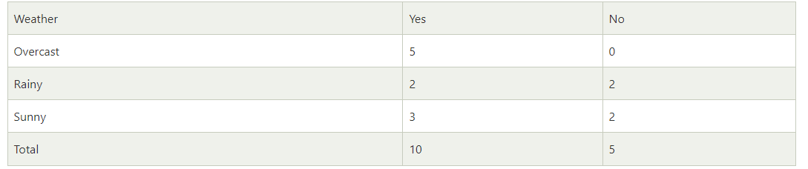
Working of Naïve Bayes' Classifier
Frequency table for the Weather Conditions:
Notes:
So to solve this problem, we need to follow the below steps:
Convert the given dataset into frequency tables.
Generate Likelihood table by finding the probabilities of given features.
Now, use Bayes theorem to calculate the posterior probability.
Problem: If the weather is sunny, then the Player should play or not?
Solution: To solve this, first consider the below dataset:

Slide 12
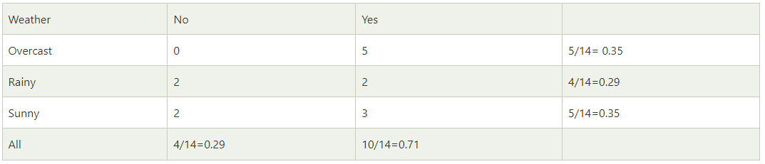
Working of Naïve Bayes' Classifier
Likelihood table weather condition:
Notes:
So to solve this problem, we need to follow the below steps:
Convert the given dataset into frequency tables.
Generate Likelihood table by finding the probabilities of given features.
Now, use Bayes theorem to calculate the posterior probability.
Problem: If the weather is sunny, then the Player should play or not?
Solution: To solve this, first consider the below dataset:

Slide 13
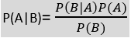
Working of Naïve Bayes' Classifier
Applying Bayes'theorem:
P(Yes|Sunny)= P(Sunny|Yes)*P(Yes)/P(Sunny)
P(Sunny|Yes)= 3/10= 0.3
P(Sunny)= 0.35
P(Yes)=0.71
P(Yes|Sunny) = 0.3*0.71/0.35= 0.60
P(No|Sunny)= P(Sunny|No)*P(No)/P(Sunny)
P(Sunny|NO)= 2/4=0.5
P(No)= 0.29
P(Sunny)= 0.35
So P(No|Sunny)= 0.5*0.29/0.35 = 0.41
So as we can see from the above calculation that
P(Yes|Sunny)>P(No|Sunny)
Hence on a Sunny day, Player can play the game.
Notes:
So to solve this problem, we need to follow the below steps:
Convert the given dataset into frequency tables.
Generate Likelihood table by finding the probabilities of given features.
Now, use Bayes theorem to calculate the posterior probability.
Problem: If the weather is sunny, then the Player should play or not?
Solution: To solve this, first consider the below dataset:

Slide 14
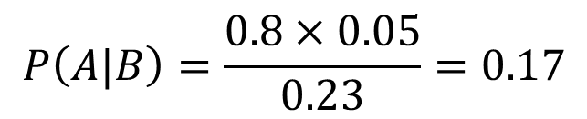
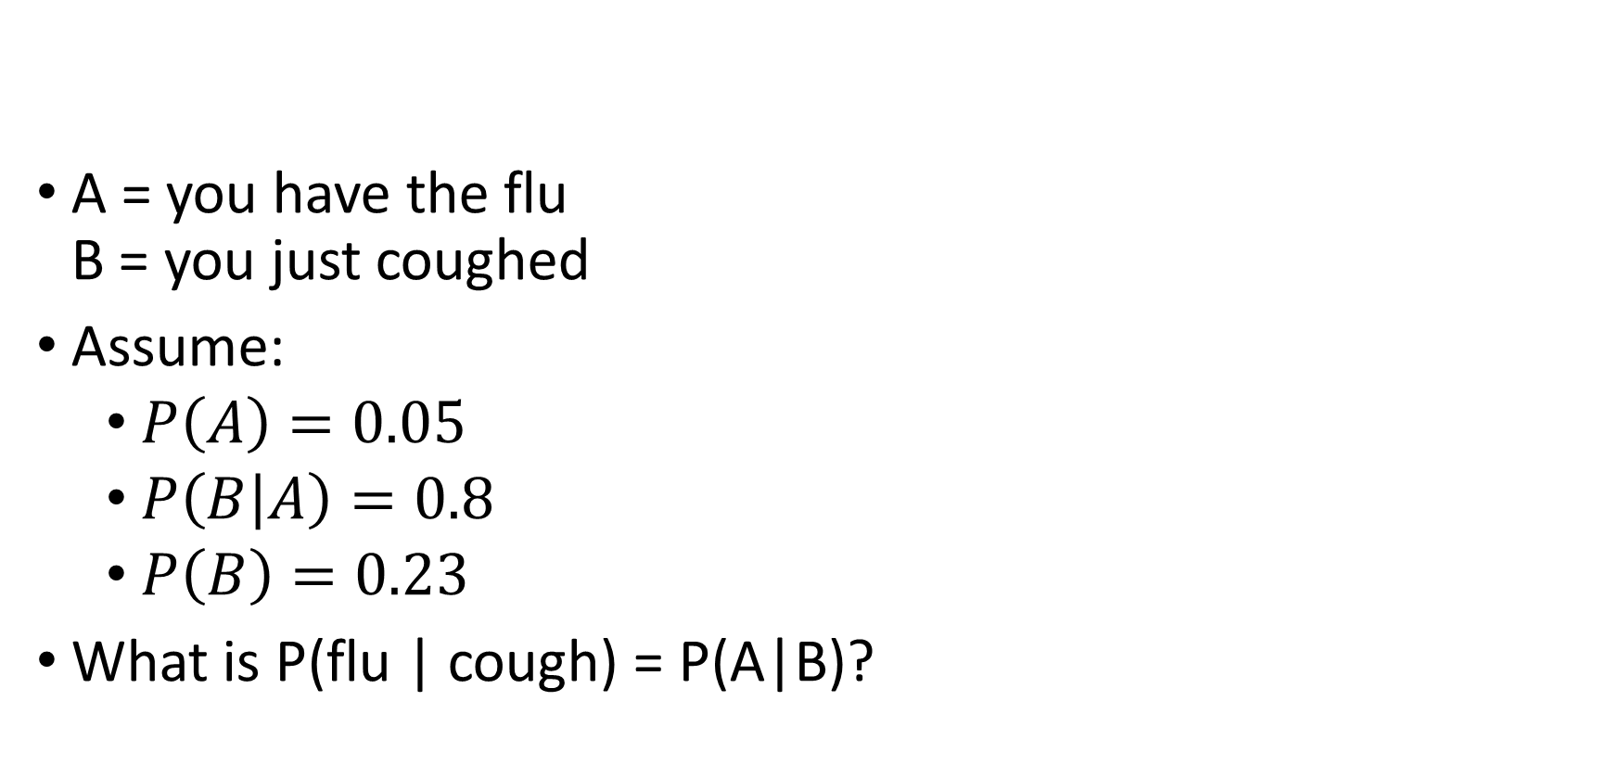
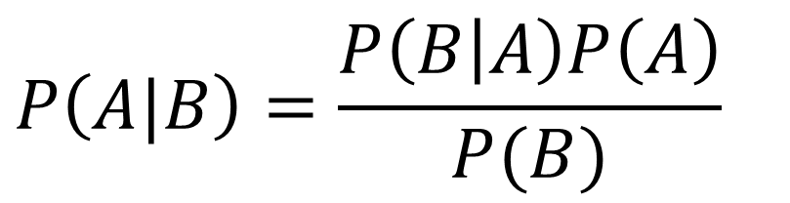
Applying Bayes rule
$$P\left(A|B\right)=\frac{P\left(B | A\right)P\left(A\right)}{P(B)}$$
A = you have the flu B = you just coughed
Assume:
$P\left(A\right)=0.05$
$P\left(B | A\right)=0.8$
$P\left(B\right)=0.23$
What is P(flu | cough) = P(A|B)?
$$P\left(A|B\right)=\frac{0.8×0.05}{0.23}=0.17$$

Slide 15
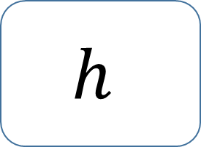
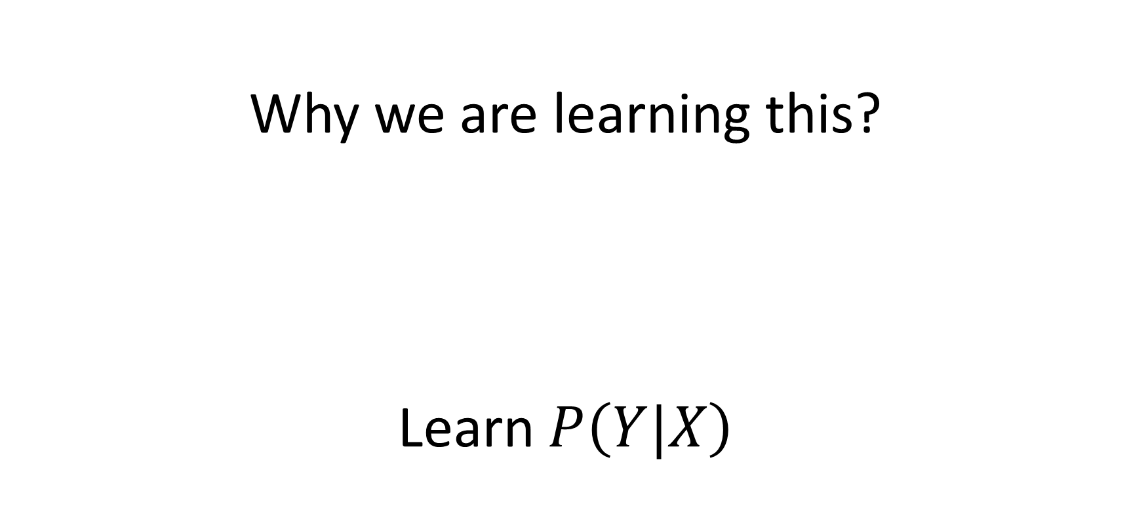
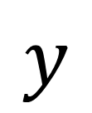
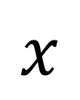
Why we are learning this?
Learn $P\left(Y|X\right)$
$$h$$
$$x$$
$$y$$
Hypothesis

Slide 16
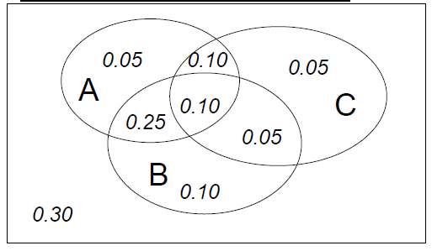
Joint distribution
A | B | C | Prob
0 | 0 | 0 | 0.30
0 | 0 | 1 | 0.05
0 | 1 | 0 | 0.10
0 | 1 | 1 | 0.05
1 | 0 | 0 | 0.05
1 | 0 | 1 | 0.10
1 | 1 | 0 | 0.25
1 | 1 | 1 | 0.10
Making a joint distribution of M variables
Make a truth table listing all combinations
For each combination of values, say how probable it is
Probability must sum to 1

Slide 17
Types of Naïve Bayes Model:
Gaussian: The Gaussian model assumes that features follow a normal distribution. This means if predictors take continuous values instead of discrete, then the model assumes that these values are sampled from the Gaussian distribution.
Multinomial: The Multinomial Naïve Bayes classifier is used when the data is multinomial distributed. It is primarily used for document classification problems, it means a particular document belongs to which category such as Sports, Politics, education, etc. The classifier uses the frequency of words for the predictors.
Bernoulli: The Bernoulli classifier works similar to the Multinomial classifier, but the predictor variables are the independent Booleans variables. Such as if a particular word is present or not in a document. This model is also famous for document classification tasks.

Slide 18
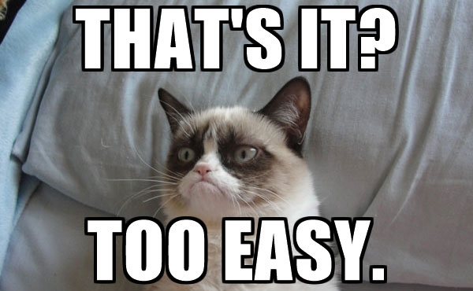

Slide 19
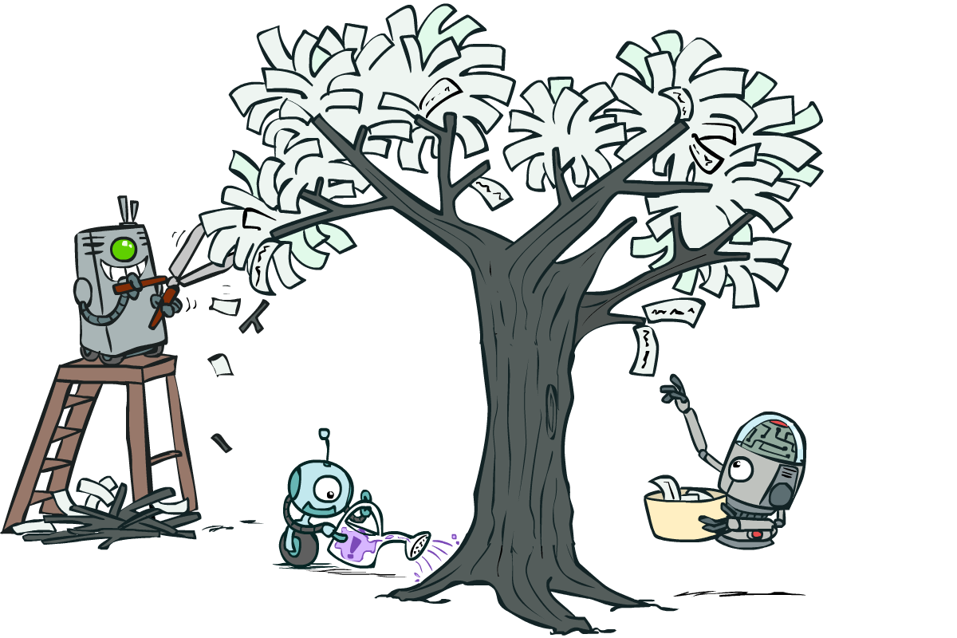
CART (Classification And Regression Tree)

Slide 20
Decision Trees

Slide 21
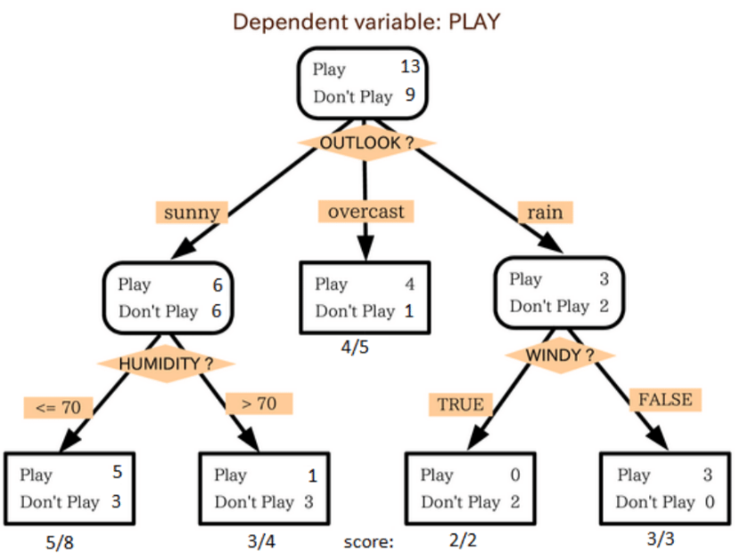
Decision Tree
Decision tree algorithm falls under the category of supervised learning.
It can be used to solve both regression and classification problems.

Slide 22
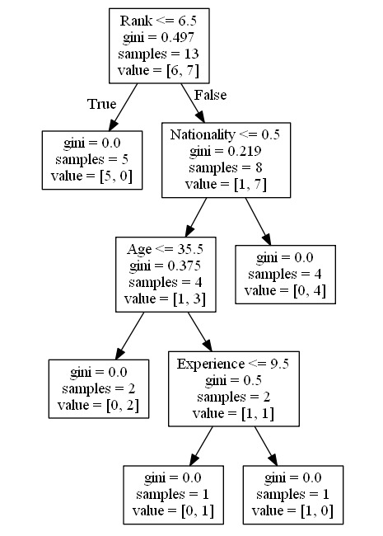
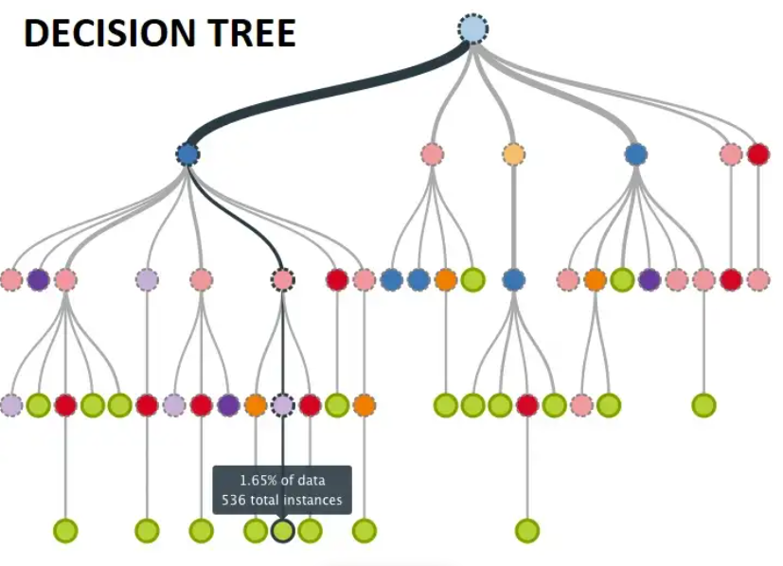
Decision Tree
Decision tree uses the tree representation to solve the problem in which each leaf node corresponds to a class label and attributes are represented on the internal node of the tree.

Slide 23

Decision Tree
It is a tree-structured classifier/regressor, where internal nodes represent the features of a dataset, branches represent the decision rules and each leaf node represents the outcome.

Slide 24
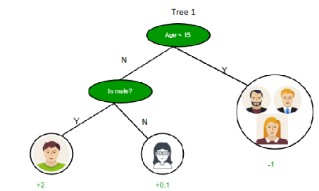
Decision Tree
In a Decision tree, there are two nodes, which are the Decision Node and Leaf Node.
Decision nodes are used to make any decision and have multiple branches, whereas Leaf nodes are the output of those decisions and do not contain any further branches.

Slide 25
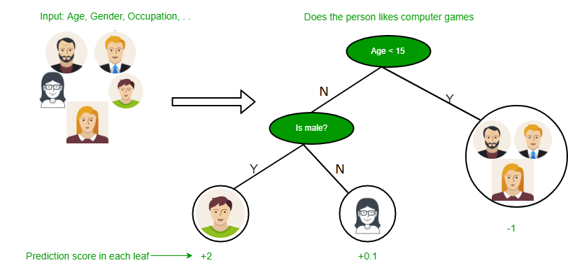
Decision Tree
Notes:
It is a graphical representation for getting all the possible solutions to a problem/decision based on given conditions.
It is called a decision tree because, similar to a tree, it starts with the root node, which expands on further branches and constructs a tree-like structure.

Slide 26

Decision Tree
A decision tree simply asks a question, and based on the answer (Yes/No), it further split the tree into subtrees.
Notes:
This diagram explains the general structure of a decision tree:

Slide 27
Decision Tree Terminologies
Root Node: Root node is from where the decision tree starts. It represents the entire dataset, which further gets divided into two or more homogeneous sets.
Leaf Node: Leaf nodes are the final output node, and the tree cannot be segregated further after getting a leaf node.
Splitting: Splitting is the process of dividing the decision node/root node into sub-nodes according to the given conditions.
Branch/Sub Tree: A tree formed by splitting the tree.
Pruning: Pruning is the process of removing the unwanted branches from the tree.
Parent/Child node: The root node of the tree is called the parent node, and other nodes are called the child nodes.

Slide 28
How does the Decision Tree algorithm Work?
Step-1: Begin the tree with the root node, says S, which contains the complete dataset.
Step-2: Find the best attribute in the dataset using Attribute Selection Measure(ASM).
Step-3: Divide the S into subsets that contains possible values for the best attributes.
Step-4: Generate the decision tree node, which contains the best attribute.
Step-5: Recursively make new decision trees using the subsets of the dataset created in step -3. Continue this process until a stage is reached where you cannot further classify the nodes and called the final node as a leaf node.

Slide 29
Example
Example: Suppose there is a candidate who has a job offer and wants to decide whether he should accept the offer or Not. So, to solve this problem, the decision tree starts with the root node (Salary attribute by ASM). The root node splits further into the next decision node (distance from the office) and one leaf node based on the corresponding labels. The next decision node further gets split into one decision node (Cab facility) and one leaf node. Finally, the decision node splits into two leaf nodes (Accepted offers and Declined offer). Draw the decision tree graph.

Slide 30
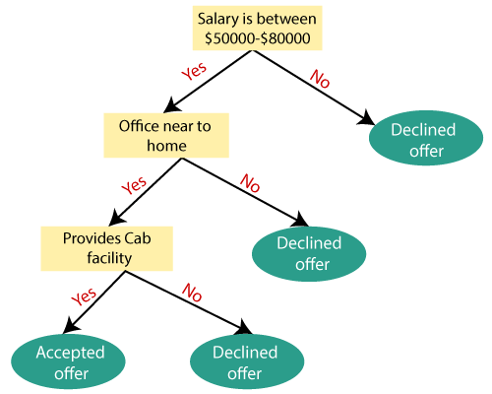
Example

Slide 31
Attribute Selection Measures
While implementing a Decision tree, the main issue arises that how to select the best attribute for the root node and for sub-nodes.
To solve such problems there is a technique which is called as Attribute selection measure or ASM.
By this measurement, we can easily select the best attribute for the nodes of the tree.
There are two popular techniques for ASM, which are:
Information Gain
Gini Index

Slide 32
Information Gain
Information gain is the measurement of changes in entropy after the segmentation of a dataset based on an attribute.
It calculates how much information a feature provides us about a class.
According to the value of information gain, we split the node and build the decision tree.
A decision tree algorithm always tries to maximize the value of information gain, and a node/attribute having the highest information gain is split first.
It can be calculated using the below formula:

Slide 33
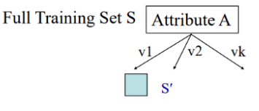
Information Gain
Suppose S is a set of instances, A is an attribute, Sv is the subset of S with A = v, and Values (A) is the set of all possible values of A

Slide 34
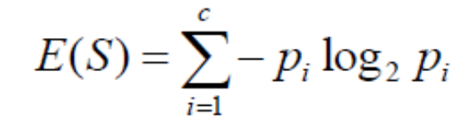
Entropy
Entropy is a metric to measure the impurity in a given attribute.
It specifies randomness in data.
Mathematically Entropy for one attribute is represented as:

Slide 35
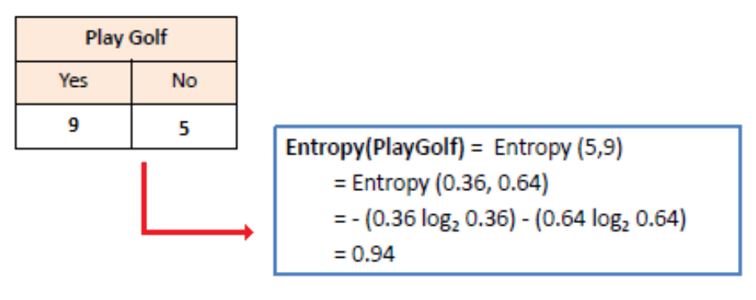
Entropy
S → Current state,
Pi → Probability of an event i of state S or Percentage of class i in a node of state S.

Slide 36
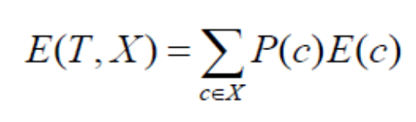
Entropy
Mathematically Entropy for multiple attributes is represented as:
T→ Current state
X → Selected attribute

Slide 37
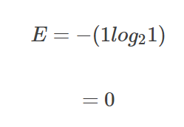
Entropy
You might wonder, what happens when all observations belong to the same class? In such a case, the entropy will always be zero.

Slide 38
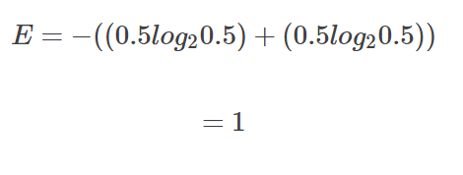
Entropy
Such a dataset has no impurity. This implies that such a dataset would not be useful for learning.
However, if we have a dataset with say, two classes, half made up of yellow and the other half being purple, the entropy will be one.

Slide 39
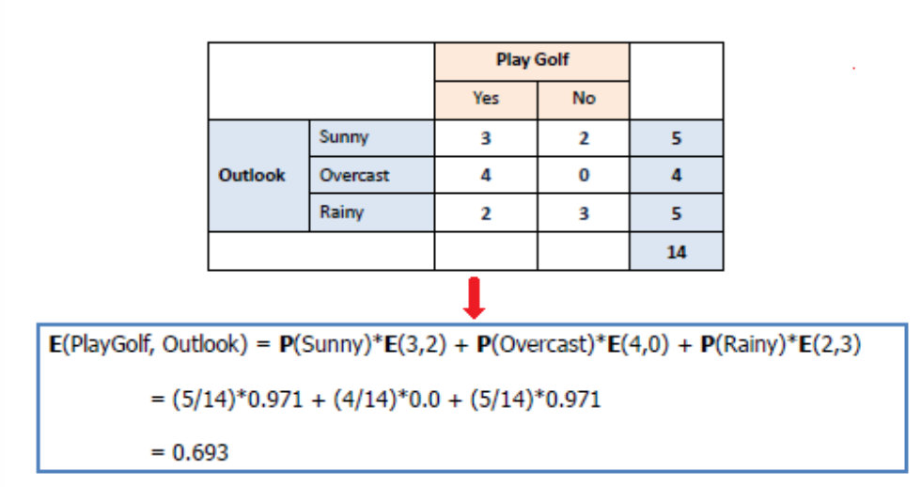
Entropy

Slide 40
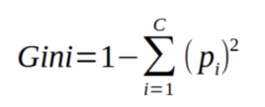
Gini Index
Gini index is a measure of impurity or purity used while creating a decision tree in the CART(Classification and Regression Tree) algorithm.
Gini Index is a metric to measure how often a randomly chosen element would be incorrectly identified.
An attribute with the low Gini index should be preferred as compared to the high Gini index.
It only creates binary splits, and the CART algorithm uses the Gini index to create binary splits.
Gini index can be calculated using the below formula:
Notes:
Gini Index is a score that evaluates how accurate a split is among the classified groups. Gini index evaluates a score in the range between 0 and 1, where 0 is when all observations belong to one class, and 1 is a random distribution of the elements within classes. In this case, we want to have a Gini index score as low as possible. Gini Index is the evaluation metrics we shall use to evaluate our Decision Tree Model.

Slide 41
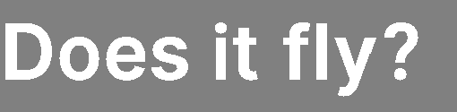
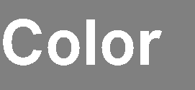
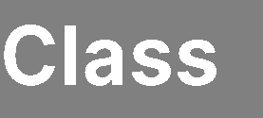

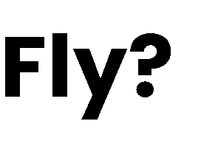
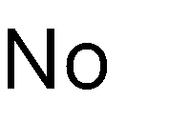
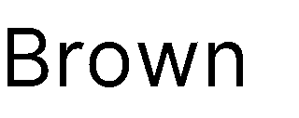
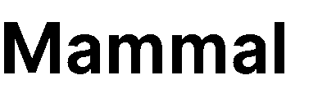
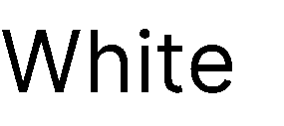
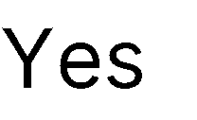
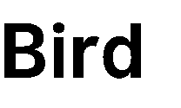
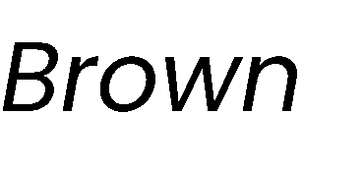
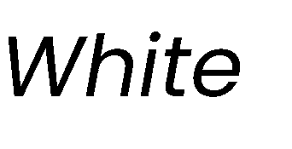
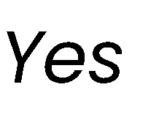
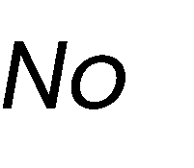
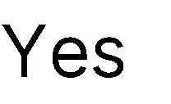
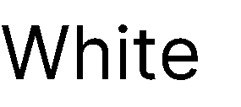

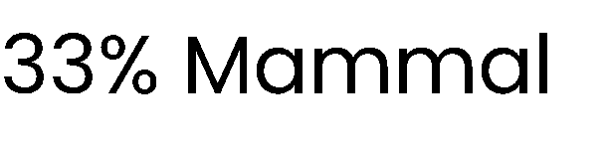
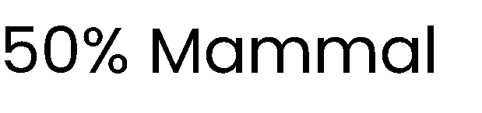
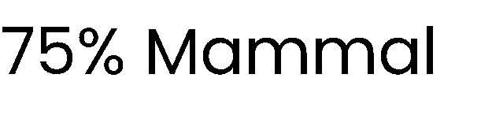




What is a good attribute?
Which attribute provides better splitting?
Why?
Because the resulting subsets are more pure
Knowing the value of this attribute gives us more information about the label
(the entropy of the subsets is lower)

Slide 42


























Entropy
Entropy measures the degree of randomness in data
For a set of samples $X$ with $k$ classes:
$$entropy\left(X\right)=−\sum_{i=1}^{k}{p_{i}\log_{2}{(p_{i})}}$$
where $pi$ is the proportion of elements of class $i$
Lower entropy implies greater predictability!

Slide 43

Information Gain
The information gain of an attribute a is the expected reduction in entropy due to splitting on values of a:
$$gain\left(X,a\right)=entropy\left(X\right)−\sum_{v ∈ Values(a)}{\frac{\left|X_{v}\right|}{\left|X\right|}entropy(X_{v})}$$
where $Xv$ is the subset of $X$ for which $a = v$

Slide 44





















Best attribute = highest information gain
$$entropy \left(X\right)= − pmammal log2 pmammal−pbird log2 pbird=−\frac{3}{7} log2\frac{3}{7}−\frac{4}{7}log2\frac{4}{7}≈ 0.985$$

Slide 45




Best attribute = highest information gain
$$entropy \left(X\right)= − pmammal log2 pmammal−pbird log2 pbird=−\frac{3}{7} log2\frac{3}{7}−\frac{4}{7}log2\frac{4}{7}≈ 0.985$$
$$entropy (X_{color=brown}) = −\frac{1}{3} log2\frac{1}{3}−\frac{2}{3} log2\frac{2}{3}≈ 0.918$$

Slide 46



Best attribute = highest information gain
$$entropy \left(X\right)= − pmammal log2 pmammal−pbird log2 pbird=−\frac{3}{7} log2\frac{3}{7}−\frac{4}{7}log2\frac{4}{7}≈ 0.985$$
$$entropy (X_{color=brown}) = −\frac{1}{3} log2\frac{1}{3}−\frac{2}{3} log2\frac{2}{3}≈ 0.918$$
$$entropy (X_{color=white}) =1$$

Slide 47
Best attribute = highest information gain
$$entropy \left(X\right)= − pmammal log2 pmammal−pbird log2 pbird=−\frac{3}{7} log2\frac{3}{7}−\frac{4}{7}log2\frac{4}{7}≈ 0.985$$
$$entropy (X_{color=brown}) = −\frac{1}{3} log2\frac{1}{3}−\frac{2}{3} log2\frac{2}{3}≈ 0.918$$
$$entropy (X_{color=white}) =1$$
$$gain \left(X, color\right)=0.985−\frac{3}{7}∙0.918−\frac{4}{7}∙1≈0.020$$

Slide 48



Best attribute = highest information gain
$$entropy \left(X\right)= − pmammal log2 pmammal−pbird log2 pbird=−\frac{3}{7} log2\frac{3}{7}−\frac{4}{7}log2\frac{4}{7}≈ 0.985$$
$$entropy (X_{color=brown}) = −\frac{1}{3} log2\frac{1}{3}−\frac{2}{3} log2\frac{2}{3}≈ 0.918$$
$$entropy (X_{color=white}) =1$$
$$gain \left(X, color\right)=0.985−\frac{3}{7}∙0.918−\frac{4}{7}∙1≈0.020$$
$$entropy (X_{fly=yes}) =0$$

Slide 49




Best attribute = highest information gain
$$entropy \left(X\right)= − pmammal log2 pmammal−pbird log2 pbird=−\frac{3}{7} log2\frac{3}{7}−\frac{4}{7}log2\frac{4}{7}≈ 0.985$$
$$entropy (X_{color=brown}) = −\frac{1}{3} log2\frac{1}{3}−\frac{2}{3} log2\frac{2}{3}≈ 0.918$$
$$entropy (X_{color=white}) =1$$
$$gain \left(X, color\right)=0.985−\frac{3}{7}∙0.918−\frac{4}{7}∙1≈0.020$$
$$entropy (X_{fly=no}) = −\frac{3}{4} log2\frac{3}{4}−\frac{1}{4} log2\frac{1}{4}≈ 0. 811$$
$$entropy (X_{fly=yes}) =0$$

Slide 50

Best attribute = highest information gain
In practice, we compute $entropy(X)$ only once!
$$entropy \left(X\right)= − pmammal log2 pmammal−pbird log2 pbird=−\frac{3}{7} log2\frac{3}{7}−\frac{4}{7}log2\frac{4}{7}≈ 0.985$$
$$entropy (X_{color=brown}) = −\frac{1}{3} log2\frac{1}{3}−\frac{2}{3} log2\frac{2}{3}≈ 0.918$$
$$entropy (X_{color=white}) =1$$
$$gain \left(X, color\right)=0.985−\frac{3}{7}∙0.918−\frac{4}{7}∙1≈0.020$$
$$entropy (X_{fly=no}) = −\frac{3}{4} log2\frac{3}{4}−\frac{1}{4} log2\frac{1}{4}≈ 0. 811$$
$$entropy (X_{fly=yes}) =0$$
$$gain \left(X, fly\right)=0.985−\frac{3}{7}∙0−\frac{4}{7}∙0.811≈0.521$$

Slide 51



















Gini Impurity
Gini impurity measures how often a randomly chosen example would be incorrectly labeled if it was randomly labeled according to the label distribution
For a set of samples $X$ with $k$ classes:
$$gini\left(X\right)=1−\sum_{i=1}^{k}{p_{i}^{2}}$$
where $pi$ is the proportion of elements of class $i$
Can be used as an alternative to entropy for selecting attributes!

Slide 52





Best attribute = highest impurity decrease
In practice, we compute $gini(X)$ only once!
$$gini \left(X\right)=1 −{\left(\frac{3}{7}\right)}^{2}−{\left(\frac{4}{7}\right)}^{2}≈ 0.489$$
$$gini (X_{color=brown}) =1 −{\left(\frac{1}{3}\right)}^{2}−{\left(\frac{2}{3}\right)}^{2}≈ 0.444$$
$$gini (X_{color=white}) =0.5$$
$$△gini \left(X, color\right)=0.489−\frac{3}{7}∙0.444−\frac{4}{7}∙0.5≈0.013$$
$$gini (X_{fly=no}) =1 −{\left(\frac{3}{4}\right)}^{2}−{\left(\frac{1}{4}\right)}^{2}≈ 0. 375$$
$$gini (X_{fly=yes}) =0$$
$$△gini \left(X, fly\right)=0.489−\frac{3}{7}∙0−\frac{4}{7}∙0.375≈0.274$$

Slide 53

Entropy versus Gini Impurity
Entropy and Gini Impurity give similar results in practice
They only disagree in about 2% of cases
Entropy might be slower to compute, because of the log

Slide 54


Decision Tree
The decision tree uses your earlier decisions to calculate the odds for you to wanting to go see a comedian or not.
Notes:
Gini Index is a score that evaluates how accurate a split is among the classified groups. Gini index evaluates a score in the range between 0 and 1, where 0 is when all observations belong to one class, and 1 is a random distribution of the elements within classes. In this case, we want to have a Gini index score as low as possible. Gini Index is the evaluation metrics we shall use to evaluate our Decision Tree Model.

Slide 55

Decision Tree
The next step contains two boxes, one box for the comedians with a 'Rank' of 6.5 or lower, and one box with the rest.
True - 5 Comedians End Here:
gini = 0.0 means all of the samples got the same result.
samples = 5 means that there are 5 comedians left in this branch (5 comedian with a Rank of 6.5 or lower).
value = [5, 0] means that 5 will get a "NO" and 0 will get a "GO".
False - 8 Comedians Continue:
Nationality
Nationality <= 0.5 means that the comedians with a nationality value of less than 0.5 will follow the arrow to the left (which means everyone from the UK ), and the rest will follow the arrow to the right.
gini = 0.219 means that about 22% of the samples would go in one direction.
samples = 8 means that there are 8 comedians left in this branch (8 comedian with a Rank higher than 6.5).
value = [1, 7] means that of these 8 comedians, 1 will get a "NO" and 7 will get a "GO".
Notes:
Gini Index is a score that evaluates how accurate a split is among the classified groups. Gini index evaluates a score in the range between 0 and 1, where 0 is when all observations belong to one class, and 1 is a random distribution of the elements within classes. In this case, we want to have a Gini index score as low as possible. Gini Index is the evaluation metrics we shall use to evaluate our Decision Tree Model.

Slide 56

Decision Tree
True - 4 Comedians Continue:
Age
Age <= 35.5 means that comedians at the age of 35.5 or younger will follow the arrow to the left, and the rest will follow the arrow to the right.
gini = 0.375 means that about 37,5% of the samples would go in one direction.
samples = 4 means that there are 4 comedians left in this branch (4 comedians from the UK).
value = [1, 3] means that of these 4 comedians, 1 will get a "NO" and 3 will get a "GO".
False - 4 Comedians End Here:
gini = 0.0 means all of the samples got the same result.
samples = 4 means that there are 4 comedians left in this branch (4 comedians not from the UK).
value = [0, 4] means that of these 4 comedians, 0 will get a "NO" and 4 will get a "GO".
Notes:
Gini Index is a score that evaluates how accurate a split is among the classified groups. Gini index evaluates a score in the range between 0 and 1, where 0 is when all observations belong to one class, and 1 is a random distribution of the elements within classes. In this case, we want to have a Gini index score as low as possible. Gini Index is the evaluation metrics we shall use to evaluate our Decision Tree Model.

Slide 57

Decision Tree
True - 2 Comedians End Here:
gini = 0.0 means all of the samples got the same result.
samples = 2 means that there are 2 comedians left in this branch (2 comedians at the age 35.5 or younger).
value = [0, 2] means that of these 2 comedians, 0 will get a "NO" and 2 will get a "GO".
False - 2 Comedians Continue:
Experience
Experience <= 9.5 means that comedians with 9.5 years of experience, or less, will follow the arrow to the left, and the rest will follow the arrow to the right.
gini = 0.5 means that 50% of the samples would go in one direction.
samples = 2 means that there are 2 comedians left in this branch (2 comedians older than 35.5).
value = [1, 1] means that of these 2 comedians, 1 will get a "NO" and 1 will get a "GO".
Notes:
Gini Index is a score that evaluates how accurate a split is among the classified groups. Gini index evaluates a score in the range between 0 and 1, where 0 is when all observations belong to one class, and 1 is a random distribution of the elements within classes. In this case, we want to have a Gini index score as low as possible. Gini Index is the evaluation metrics we shall use to evaluate our Decision Tree Model.

Slide 58

Decision Tree
True - 1 Comedian Ends Here:
gini = 0.0 means all of the samples got the same result.
samples = 1 means that there is 1 comedian left in this branch (1 comedian with 9.5 years of experience or less).
value = [0, 1] means that 0 will get a "NO" and 1 will get a "GO".
False - 1 Comedian Ends Here:
gini = 0.0 means all of the samples got the same result.
samples = 1 means that there is 1 comedians left in this branch (1 comedian with more than 9.5 years of experience).
value = [1, 0] means that 1 will get a "NO" and 0 will get a "GO".
Notes:
Gini Index is a score that evaluates how accurate a split is among the classified groups. Gini index evaluates a score in the range between 0 and 1, where 0 is when all observations belong to one class, and 1 is a random distribution of the elements within classes. In this case, we want to have a Gini index score as low as possible. Gini Index is the evaluation metrics we shall use to evaluate our Decision Tree Model.

Slide 59
Pruning

Slide 60
Pruning
Pruning is a technique that reduces the size of a decision tree by removing branches of the tree which provide little predictive power
It is a regularization method that reduces the complexity of the final model, thus reducing overfitting
Decision trees are prone to overfitting!
Pruning methods:
Pre-pruning: Stop the tree building algorithm before it fully classifies the data
Post-pruning: Build the complete tree, then replace some non-leaf nodes with leaf nodes if this improves validation error

Slide 61








Pre-pruning
Minimum threshold on entropy
𝜽_{𝒆𝒏𝒕} = 𝟎. 𝟒
Pre-pruning implies early stopping:
If some condition is met, the current node will not be split, even if it is not 100% pure
It will become a leaf node with the label of the majority class in the current set
(the class distribution could be used as prediction confidence)
Common stopping criteria include setting a threshold on:
Entropy (or Gini Impurity) of the current set
Number of samples in the current set
Gain of the best-splitting attribute
Depth of the tree
$$entropy(54|5)= 0.29 < θent$$
Stop, even if node can be split
91.52% confidence

Slide 62





Post-pruning
Prune nodes in a bottom-up manner, if it decreases validation error

Slide 63

Post-pruning
Prune nodes in a bottom-up manner, if it decreases validation error

Slide 64

Post-pruning
Prune nodes in a bottom-up manner, if it decreases validation error

Slide 65
Handling Numerical Attributes

Slide 66










































Handling numerical attributes
How does the algorithm handle numerical attributes?
Any numerical attribute would almost always bring entropy down to zero
This means it will completely overfit the training data
Consider a numerical value for humidity

Slide 67

























Handling numerical attributes
Numerical attributes have to be treated differently
Find the best splitting value
Gain of numerical attribute $a$ if we split at value $t$
$$gain\left(X, a, t\right)= entropy\left(X\right)−\frac{\left|X_{a≤t}\right|}{\left|X\right|}entropy\left(X_{a≤t}\right)−\frac{\left|X_{a>t}\right|}{\left|X\right|}entropy\left(X_{a>t}\right)$$
Mean of each consecutive pair
Sort

Slide 68
Handling numerical attributes
Numerical attributes have to be treated differently
Find the best splitting value
$$gain\left(X, a, t\right)= entropy\left(X\right)−\frac{\left|X_{a≤t}\right|}{\left|X\right|}entropy\left(X_{a≤t}\right)−\frac{\left|X_{a>t}\right|}{\left|X\right|}entropy\left(X_{a>t}\right)$$
Mean of each consecutive pair
Sort
$$gain \left(X, humidity, 83.5\right)=$$

Slide 69
Handling numerical attributes
Numerical attributes have to be treated differently
Find the best splitting value
$$gain\left(X, a, t\right)= entropy\left(X\right)−\frac{\left|X_{a≤t}\right|}{\left|X\right|}entropy\left(X_{a≤t}\right)−\frac{\left|X_{a>t}\right|}{\left|X\right|}entropy\left(X_{a>t}\right)$$
Mean of each consecutive pair
Sort
$$gain \left(X, humidity, 83.5\right)=0.94$$

Slide 70

Handling numerical attributes
Numerical attributes have to be treated differently
Find the best splitting value
$$gain\left(X, a, t\right)= entropy\left(X\right)−\frac{\left|X_{a≤t}\right|}{\left|X\right|}entropy\left(X_{a≤t}\right)−\frac{\left|X_{a>t}\right|}{\left|X\right|}entropy\left(X_{a>t}\right)$$
Mean of each consecutive pair
Sort
$$gain \left(X, humidity, 83.5\right)=0.94−\frac{7}{14}∙0.59$$

Slide 71
Handling numerical attributes
Numerical attributes have to be treated differently
Find the best splitting value
$$gain\left(X, a, t\right)= entropy\left(X\right)−\frac{\left|X_{a≤t}\right|}{\left|X\right|}entropy\left(X_{a≤t}\right)−\frac{\left|X_{a>t}\right|}{\left|X\right|}entropy\left(X_{a>t}\right)$$
Mean of each consecutive pair
Sort
$$gain \left(X, humidity, 83.5\right)=0.94−\frac{7}{14}∙0.59−\frac{7}{14}∙0.98$$

Slide 72

Handling numerical attributes
Numerical attributes have to be treated differently
Find the best splitting value
$$gain\left(X, a, t\right)= entropy\left(X\right)−\frac{\left|X_{a≤t}\right|}{\left|X\right|}entropy\left(X_{a≤t}\right)−\frac{\left|X_{a>t}\right|}{\left|X\right|}entropy\left(X_{a>t}\right)$$
Mean of each consecutive pair
Sort
$$gain \left(X, humidity, 83.5\right)=0.94−\frac{7}{14}∙0.59−\frac{7}{14}∙0.98$$
$$≈0.152$$

Slide 73















Handling numerical attributes
Numerical attributes have to be treated differently
Find the best splitting value
Mean of each consecutive pair
Gain for every candidate
Sort
83.5 is the best splitting value with an information gain of 0.152

Slide 74









Handling numerical attributes
Numerical attributes have to be treated differently
Find the best splitting value
83.5 is the best splitting value for Humidity with an information gain of 0.152
Humidity is now treated as a categorical attribute with two possible values
A new optimal split is computed at every level of the tree
A numerical attribute can be used several times in the tree, with different split values
 |  | >
 |  | >
 |  | >
 |  | >
 |  | ≤
 |  | ≤
 |  | ≤
 |  | >
 |  | ≤
 |  | ≤
 |  | ≤
 |  | >
 |  | ≤
 |  | >

Slide 75
Handling Missing Values

Slide 76













Handling missing values at training time
Data sets might have samples with missing values for some attributes
Simply ignoring them would mean throwing away a lot of information
There are better ways of handling missing values:

Slide 77






Handling missing values at training time
Data sets might have samples with missing values for some attributes
Simply ignoring them would mean throwing away a lot of information
There are better ways of handling missing values:
Set them to the most common value

Slide 78





Handling missing values at training time
Data sets might have samples with missing values for some attributes
Simply ignoring them would mean throwing away a lot of information
There are better ways of handling missing values:
Set them to the most common value
Set them to the most probable value given the label
$$P\left(Yes | Bird\right)=\frac{2}{3}= 0.66$$
$$P\left(No | Bird\right)=\frac{1}{3}= 0.33$$
$$P\left(White | Mammal\right)=1$$
$$P\left(Brown | Mammal\right)=0$$

Slide 79







Handling missing values at training time
Data sets might have samples with missing values for some attributes
Simply ignoring them would mean throwing away a lot of information
There are better ways of handling missing values:
Set them to the most common value
Set them to the most probable value given the label
Add a new instance for each possible value

Slide 80



Handling missing values at training time
Data sets might have samples with missing values for some attributes
Simply ignoring them would mean throwing away a lot of information
There are better ways of handling missing values:
Set them to the most common value
Set them to the most probable value given the label
Add a new instance for each possible value
Leave them unknown, but discard the sample when evaluating the gain of that attribute
(if the attribute is chosen for splitting, send the instances
with unknown values to all children)
$$entropy(X_{color=brown})=0$$
$$entropy(X_{color=white})=1$$
gain$\left(X | color\right)=0.985−\frac{2}{6}∙0−\frac{4}{6}∙1$
$= 0.318$

Slide 81














Handling missing values at training time
Data sets might have samples with missing values for some attributes
Simply ignoring them would mean throwing away a lot of information
There are better ways of handling missing values:
Set them to the most common value
Set them to the most probable value given the label
Add a new instance for each possible value
Leave them unknown, but discard the sample when evaluating the gain of that attribute
(if the attribute is chosen for splitting, send the instances
with unknown values to all children)
Build a decision tree on all other attributes (including label) to predict missing values
(use instances where the attribute is defined as training data)

Slide 82

Handling missing values at inference time
When we encounter a node that checks an attribute with a missing value, we explore all possibilities
Loan?
Not a student
49 years old
Unknown income
Fair credit record

Slide 83

Handling missing values at inference time
When we encounter a node that checks an attribute with a missing value, we explore all possibilities
We explore all branches and take the final prediction based on a (weighted) vote of the corresponding leaf nodes
Loan?
Not a student
49 years old
Unknown income
Fair credit record
Yes

Slide 84



Decision Boundaries
Decision trees produce non-linear decision boundaries
Support Vector Machines
Decision Tree

Slide 85








Decision Trees: Training and Inference
Training
Inference

Slide 86

Random Forests

Slide 87
Random Forests
(Ensemble learning with decision trees)

Slide 88
Random Forests
Random Forest is a popular machine learning algorithm that belongs to the supervised learning technique.
It can be used for both Classification and Regression problems in ML.
It is based on the concept of ensemble learning, which is a process of combining multiple classifiers to solve a complex problem and to improve the performance of the model.

Slide 89

Random Forests
Random Forest is a classifier that contains a number of decision trees on various subsets of the given dataset and takes the average to improve the predictive accuracy of that dataset.

Slide 90

Random Forests
The greater number of trees in the forest leads to higher accuracy and prevents the problem of overfitting.
The below diagram explains the working of the Random Forest algorithm:

Slide 91
How does Random Forest algorithm work?
Random Forest works in two-phase first is to create the random forest by combining N decision tree, and second is to make predictions for each tree created in the first phase.
The Working process can be explained in the below steps and diagram:
Step-1: Select random K data points from the training set.
Step-2: Build the decision trees associated with the selected data points (Subsets).
Step-3: Choose the number N for decision trees that you want to build.
Step-4: Repeat Step 1 & 2.
Step-5: For new data points, find the predictions of each decision tree, and assign the new data points to the category that wins the majority votes.

Slide 92

How does Random Forest algorithm work?

Slide 93
Random Forests
Random Forests:
Instead of building a single decision tree and use it to make predictions, build many different trees and combine their predictions
We have a single data set, so how do we obtain different trees?
1. Bagging (Bootstrap Aggregating):
Take random subsets of data points from the training set to create N smaller data sets
Fit a decision tree on each subset
2. Random Subspace Method (also known as Feature Bagging):
Fit N different decision trees by constraining each one to operate on a random subset of features

Slide 94







Bagging at training time
N subsets (with replacement)
Training set

Slide 95









Bagging at inference time
A test sample
75% confidence

Slide 96





































Random Subspace Method at training time
Training data

Slide 97





Random Subspace Method at inference time
A test sample
66% confidence

Slide 98


































Random Forests
Tree 1
Tree 2
Random Forest
Tree N

Slide 99
Ensemble Learning
Ensemble Learning:
Method that combines multiple learning algorithms to obtain performance improvements over its components
Random Forests are one of the most common examples of ensemble learning
Other commonly-used ensemble methods:
Bagging: multiple models on random subsets of data samples
Random Subspace Method: multiple models on random subsets of features
Boosting: train models iteratively, while making the current model focus on the mistakes of the previous ones by increasing the weight of misclassified samples

Slide 100

Boosting
All samples have the same weight

Slide 101
Boosting
All samples have the same weight
Reweight based on model’s mistakes

Slide 102
Boosting
Next model sees weighted samples

Slide 103
Boosting
Reweight based on current model’s mistakes

Slide 104
Boosting

Slide 105





Boosting

Slide 106
Summary
Ensemble Learning methods combine multiple learning algorithms to obtain performance improvements over its components
Commonly-used ensemble methods:
Bagging (multiple models on random subsets of data samples)
Random Subspace Method (multiple models on random subsets of features)
Boosting (train models iteratively, while making the current model focus on the mistakes of the previous ones by increasing the weight of misclassified samples)
Random Forests are an ensemble learning method that employ decision tree learning to build multiple trees through bagging and random subspace method.
They rectify the overfitting problem of decision trees!

